Slide 1
Chart of Accounts

Slide 2
Account
Organization– Organization Review routing
Fiscal Officer – Account routing
Sub-Fund Code – Sub-Fund routing
CG Responsibility ID – Award Routing
Campus Code – DV Routing
Effective and Expiration Dates – GL Entries
Closed Indicator – GL Entries
Indirect Cost Rate codes – GL Entries
Sufficient Funds Checking
Budget Presence Control

Slide 3
Chart of Accounts
Organization
Plant fund accounts – capital asset transactions
Organization Type – Account required
Object Code
Object consolidations and levels
Balances by Consolidation
Business Rules
Object Code Type and Object Code Sub-type
Business rules

Slide 4
General Ledger

Slide 5
GL Main Batch Processing
Nightly Processing
Data Collection
Error Correction
Collector XML
Collector Flat File
Enterprise Feeder
GLCP
Nightly Out
Scrubber
Poster
Scrubber
Collector
Enterprise
Nightly Out
Poster
PDP Entries
GLCP

Slide 6
Automated Entries
Cash Offsets
Capitalization of Assets
Plant Indebtedness
Cost Share Transfers/Encumbrances
Indirect Cost Recovery
Reversals (Pre-Encumbrance/Accruals)
Continuation Accounts
Sufficient Funds
Notes:
Many mechanical entries are automated and thus, it reduced the time for month-end closing

Slide 7
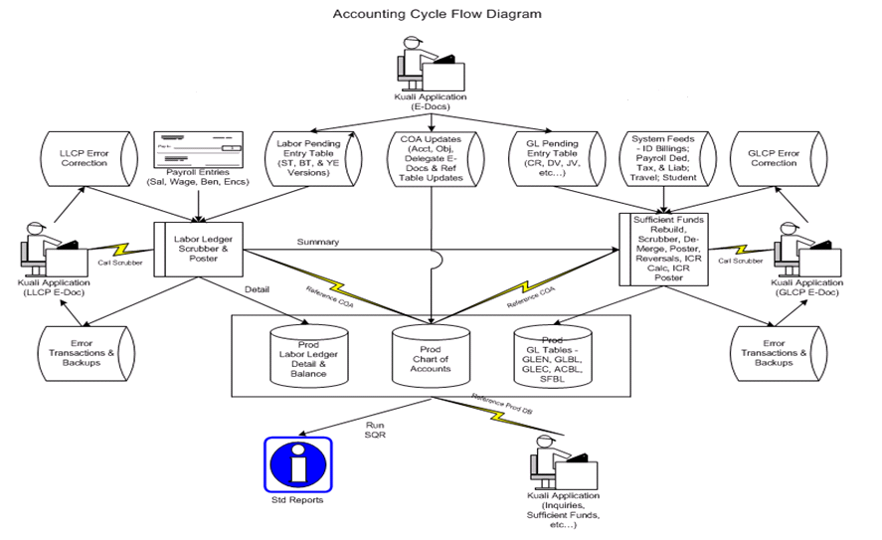
KFS Accounting Cycle Diagram

Slide 8
Year End Processing
Organization Reversions/Carryforward
Encumbrance Forward
Labor Balance Forward
Close Out Nominal Balances
Beginning Balance Carryforward
Inception to date balances

