Slide 1
Chart of Account

Slide 2
Chart of Accounts Characteristics
Hierarchical in nature
Charts report to higher level charts
Accounts report up through organizations
Accounts map to sub fund and fund groups
Object codes map to levels and consolidations
Object codes also map to object codes of higher level charts allowing for the rollup to an institutional chart for external reporting
Reports to functionality enables multiple chart of accounts

Slide 3
Chart Set-Up & Validation
What is included in the Chart of Accounts ?
E-docs – account, sub account, object code, sub object, account delegate, organization, project code
Maintenance Tables – accounting period, balance type, chart, document type, fund group, sub fund group, object consolidation, object level, object type, offset definition, origin code

Slide 4
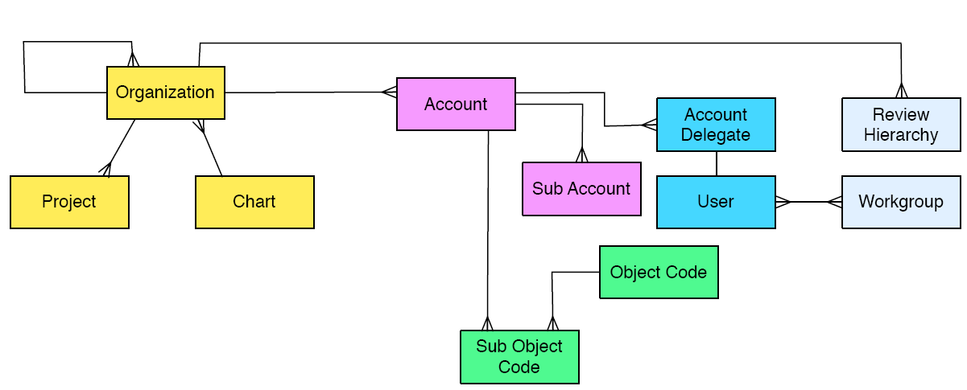
Conceptual Data Model

Slide 5
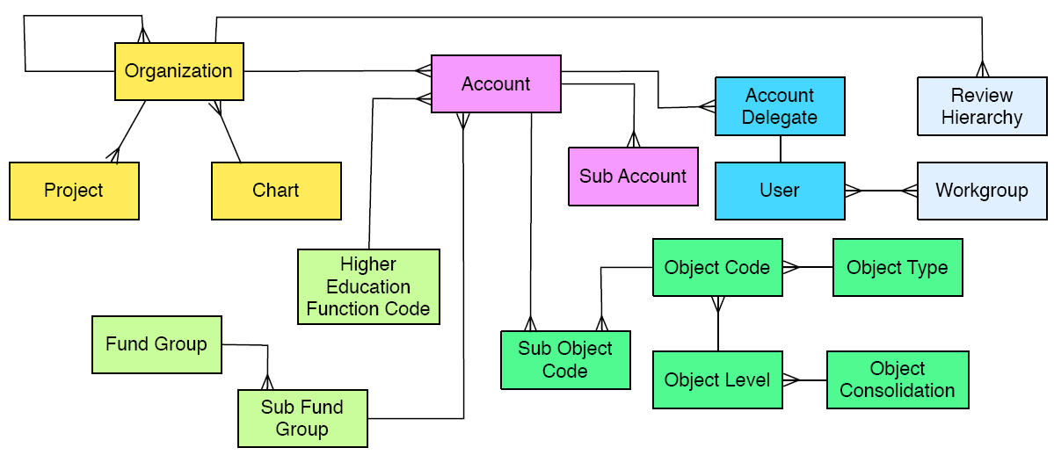
Conceptual Data Model

Slide 6
Flexible Chart of Accounts
U of Arizona
Main Campus
MC Auxiliary
AHSC
AHSC Aux

Slide 7
Organization Hierarchy at UA
U of A
Main Campus
VP for Research
VP Bus Affairs
SPS
FSO
Pre
Post
Admin
Fin’l Mgmt

Slide 8
UA Org Hierarchy with Accounts
U of A
MC
VPBus
FSO
Admin
FM
2113010
2172000

Slide 9
UA Org Heirarchy with Accounts/Sub Accounts
U of A
MC
VPBus
FSO
Admin
FM
2113010
2172000
OPFNDS
NONOP

Slide 10
Object Codes
Object Codes are detailed identifiers for Income, Expense, Asset, Liability and Fund Balances.
Chart specific
Four numeric digits
Example 1: MC-1100 “Academic Salaries”
AH-1100 “Academic Salaries”
Example 2: MA-0600 “Animal Care Income”
MC-0600 “Card Services Income”

Slide 11
Sub-Object Codes
Sub-object codes achieve further division of an object code for internal reporting purposes
Attributes of a sub-object include the following:
Specific to an account and object code
Assumes all attributes of the object code it reports to
Example: In State Travel Object Code 6000
FAC - Faculty Instate Travel
STA - Staff Instate Travel
STU - Student Instate Travel

Slide 12
Levels and Consolidations
All object codes report to a higher Level code and each Level code reports to a higher Consolidation code
Example:
Object Code 5000 “Supplies and Expense”
Level S&E “Supplies and General Expense”
Consolidation GENX “General Expenses”

