Slide 1
Kuali OLE:
Enabling Choices for Libraries
Demonstration for Wellesley College
@kualiole
Robert H. McDonald , Sharon Wiles-Young, Doreen Herold, Chulin Meng, Frances McNamara, Stuart Miller

Slide 2
What We’ll Share
What is Kuali OLE
Kuali OLE Choices
Live Demo-Lehigh University and University of Chicago

Slide 3
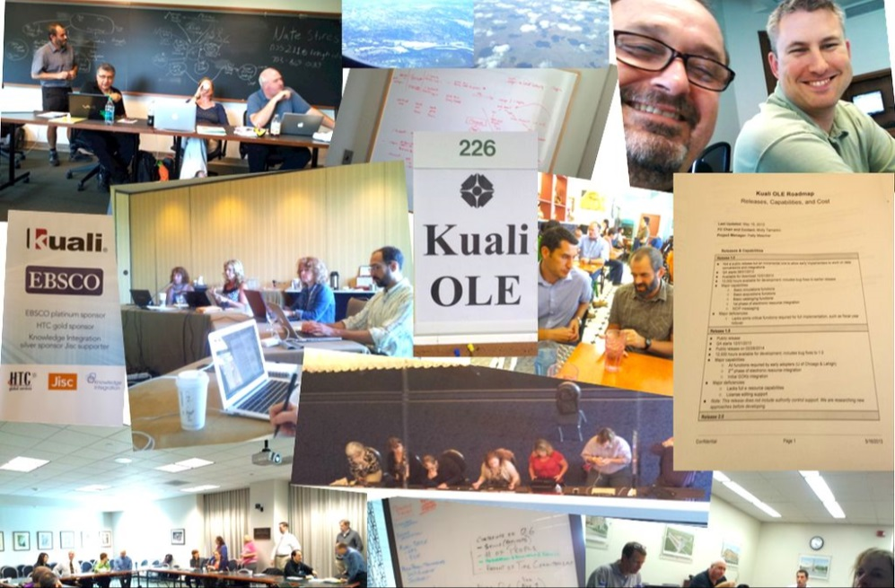
What is Kuali OLE
Community | Software | Solution
A community within a community
Part of the Kuali Foundation – Building software and community for Higher Education
66 Members, 8 Projects, 12 Commercial Affiliates
Nearly 1000 people involved
A legal entity and a philosophy
Kuali OLE Partners
Software designed by Librarians for Libraries to serve users
10 institutions, 5 KCAs & affiliates, GOKb
50+FTE including architects, coders, designers, SMEs, testers, and documenters
Funded by the Partners and the Andrew W Mellon Foundation

Slide 4
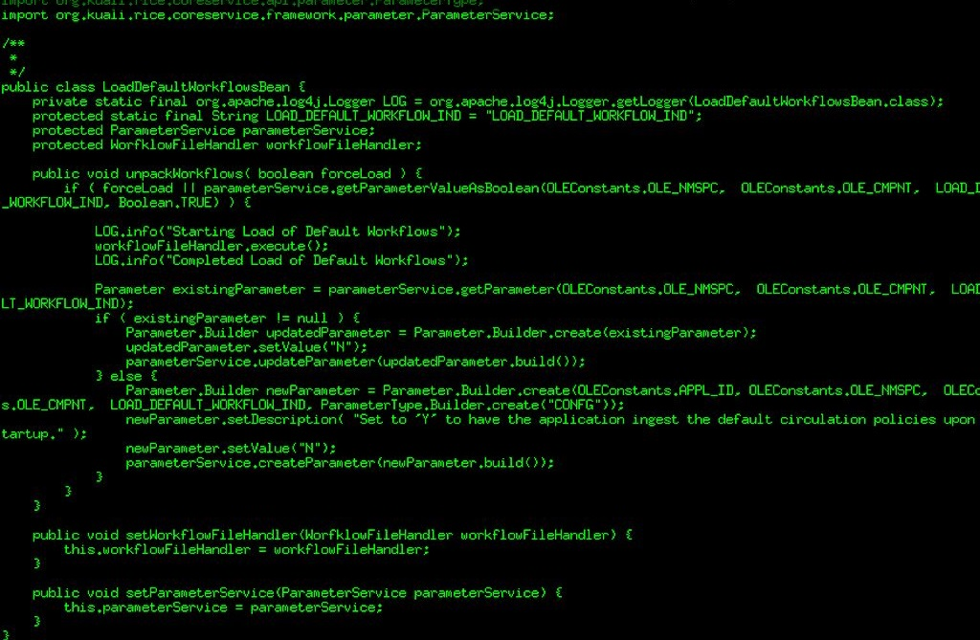
What is Kuali OLE
Community | Software | Solution
Software
Enterprise Java with services middleware
Built to integrate & interoperate
A platform for library services
Designed for libraries by librarians!
Web services APIs

Slide 5
What is Kuali OLE
Community | Software | Solution
Solution
For developing and managing a next generation, library services platform
KOLE is building to meet the following requirements:
Flexibility in design
Community ownership with an open source license and strong vendor support
Modular Service-Oriented Architecture
Enterprise-level integration
Meet current and future business needs
Sustainable design enabling the evolution of software, hardware, and mission
Integrated & Independent
Open source
Enterprise caliber
Supportive of research university scale

Slide 6
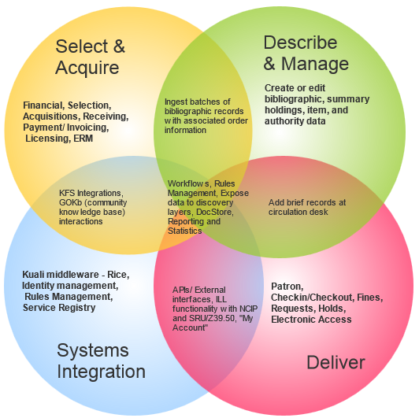
OLE Architecture
Community | Software | Solution
Four functional modules
Overlapping functionality
Iterative and maturing capabilities
Open architecture and code
Built on Kuali enterprise architecture

Slide 7
Current OLE Implementations
Community | Software | Solution
University of Chicago/Summer 2014
Lehigh University/Summer 2014
SOAS-University of London/Spring 2015
Duke University – Summer 2015-2016

Slide 8
Current OLE Partners
Community | Software | Solution
Newest Member MnPALS Consortium – January 2015

Slide 9
OLE Timeline
Community | Software | Solution
Phase 2
Mellon funding
Proof of Concept Release
OLE 1.0
OLE Planning
Grant
2008
2010
2011
2012
2013
2014
OLE 1.5
Implementations at
Lehigh University and
University of Chicago
Funded by Mellon Foundation for OLE build Project
Partner Release

Slide 10
Frances McNamara, Director of Integrated Library Systems and Administrative and Desktop Systems
Stuart Miller, Library Systems Analyst
Mark Canney, Manager of Lending Services
Chris Creswell, Senior Library Systems Analyst
Doreen Herold, Manager of Library Technical Services
Daniel Huang, Acquisitions Librarian
Lisa McColl, Metadata and Cataloging Librarian
Chulin Meng, Director of Library Technology
Michelle Suranofsky, Senior System Analyst
Sharon Wiles-Young, Director of Library Access Services

Slide 11
OUTLINE for KUALI OLE DEMO
Overview of Kuali OLE: Sharon, Frances and Stuart
Browser based
Tabs
Action list, Doc search, Search workbench
Deliver - Mark
Functionality- checkouts, etc.
Describe - Lisa
Structure of record
Import profile
S&A - Dan
Requisition to PO
Batch load
Invoice
S&A: Serials Receiving - Doreen
Record structure/action interval
Functionality
S&A: E-resource – Frances and Sharon
Functionality/ structure for 2.0
Technical Questions: Patron, Data migration. Roles and permissions-Frances, Stuart, Chulin

Slide 12
Kuali 2.0
http://www.kuali.co
Inside HigherEd: Kuali Foundation Launches Commercial Service Partner https://www.insidehighered.com/news/2014/08/25/kuali-foundation-launches-commercial-service-provider

Slide 13
More OLE
Community | Software | Solution
For more on Kuali OLE: Visit our website: http://ole.kuali.org See our Test-Drive - http://kuali.org/test-drives Visit GOKb: http://www.gokb.org Follow us on Twitter: @kualiole Read our Blog at: http://kualiole.tumblr.com Follow us on Ohloh - https://www.ohloh.net/p/kole

