Slide 1
PDP

Slide 2
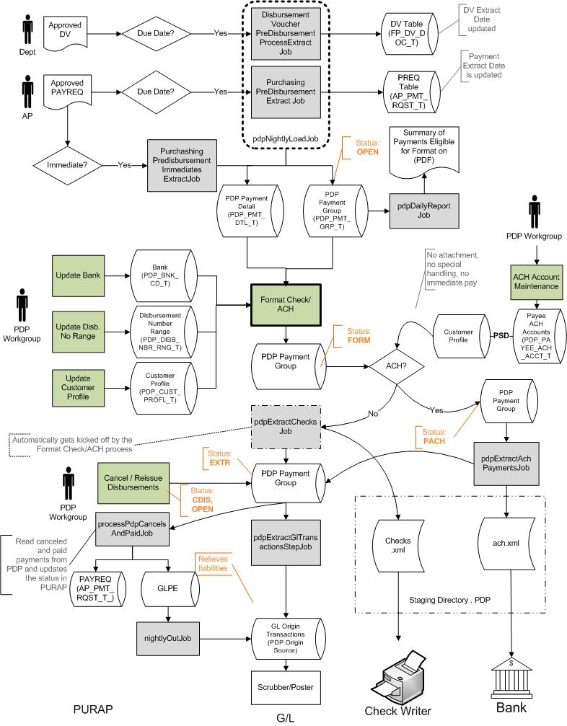

Slide 3
Setting up PDP
Set up your bank
Set up the Disbursement Range
Set up Customer Profile
ACH Bank
Payee ACH Accounts

Slide 4
Extraction
Loaded Payment Files
DV
Due Date
Immediate Disbursement
PREQ
Due Date
Approval required
Maintenance tables
Negative Payment Request Approval Limit
Payment Request Auto Approve Exclusions

Slide 5
Search for Payments
Search for all payments
PDP Payment Status Code
Open – payment has been extracted from PREQ or DV
Extr –when the check extract XML files are created.
Generating Summary of Eligible Payments Request
Job – pdpDailyReportJob – lists payments that are just extracted by PDP Extract job – payments that will be formatted in the next Format ACH/Check process

Slide 6
Format Checks/ACH
Formats disbursements and creates XML output files
Extracted check files stored in PDP staging directory
Ready to be extracted into a check writing system

Slide 7
Processing ACH as Checks
Criteria
No attachments
No special handling
PSD transaction codes match between the Customer Profile and Payee ACH account

Slide 8
Immediate Payments
DV
PREQ
PDP

Slide 9
Within PDP
Set as Immediate
Hold Payment
Cancel Payment
Cancel/Reissue

Slide 10
After payment
GL Transaction Job
Post Expense OR
Clear Liability
Paids and Cancels
Updates PREQs/DVs with Paid or Cancel info

Slide 11
Demo
Walk through Customer Profile
Batch file – pdp_daily_....pdf
Format checks/ach
Search for Payments
GL and PDP Cancels & Paids
DVs and PREQs – Disbursement Info

